Slide 1
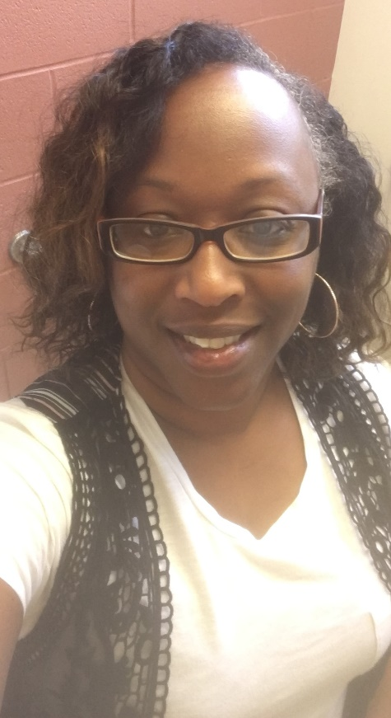
☺ Meet Ms. Lewis ☺
2021-22 is my 13th year teaching
Taught 1st through 5th grades
Hometown: Tulsa, Oklahoma
Lived in: Baton Rouge, Louisiana
Married: June 2021 to Mr. Reece ☺
Mother of 2 - son is 22, daughter is 19
Favorite colors: orange & royal blue
Favorite Restaurants: Jersey Mike’s, Chic-Fil-A, Italian and Mexican restaurants
Favorite drinks: coffee, smoothie
Favorite animals: African Elephant, Koala Bear

